Slide 1
A study of Dynamics of Pendulum with Horizontally moving Support
Project By:
Pawan (19PH20023)
Rohit Mistry (19PH20028)
Ayush Khandelwal (19ME30012)

Slide 2
Setting up the apparatus and notations
The support is modelled as a particle with mass M (will be referred to as Particle 1 for the rest of the paper). This support is constrained to move only in the horizontal direction. The bob is assumed to have mass m .(will be referred to as Particle 2 for the rest of the paper). The connector joining them is rigid and is assumed to have length l. The mass of the connector is assumed to be negligible. The above given conditions can be physically realized using a hollow bead that can slide over a horizontal support and is connected to a rigid rod (freely rotatable ) whose other end consists of a pendulum bob that can oscillate. This whole apparatus can be sandwiched between two supports so as to be able to constrain the bob to planar motion.

Slide 3
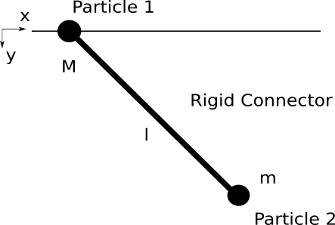
θ
Figure Showing the Particles and their respective masses.

Slide 4




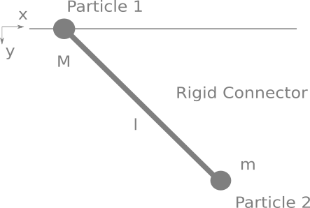


Formulating the Lagragian
The position vector of the pendulum bob can be written in terms of the generalized coordinate and the position vector of the support as earlier.
We know that . We can write the derivative of the position vector as,

Slide 5


Formulating the Kinetic Energy
The Kinetic energy of the bob can be now written as
The kinetic energy of the support is,

Slide 6


Formulation of Potential Energy
The gravitational potential energy of the bob is
The gravitational potential energy of the support is

Slide 7

Formulation of the Lagrangian
The Lagrangian now becomes,

Slide 8

The simplest Case.
Support Moves with Constant Velocity
When the support moves with constant velocity the situation is same as the one where the whole pendulum is put into a cart moving with constant velocity. So there is no difference to that with a stationary pendulum.
There is a constant term that is added to the Lagrangian,
The equation of motion becomes,

Slide 9
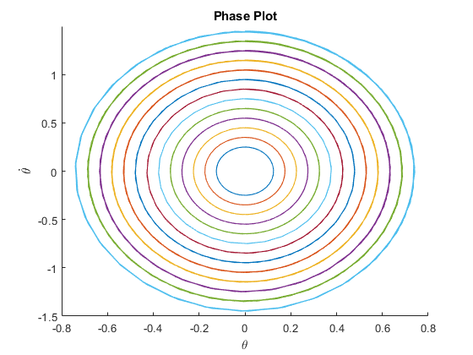
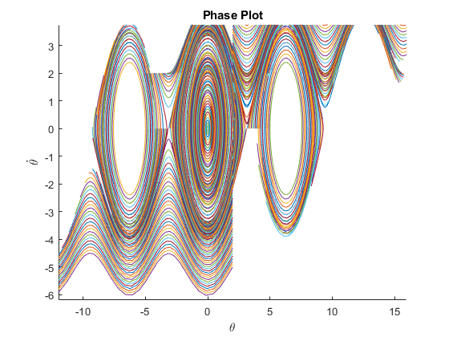
Phase Plots
Fig: Small Oscillation
Fig:Large Oscillation

Slide 10

When the Support is free
Here the forces acting on the support and the bob act is such a way to conserve the position of horizontal component of the COM of the system,
The Lagrangian is,
The equations of motion become,
From these equations we can eliminate the second derivative of x.

Slide 11
Counting Cases
The solutions of the earlier differential solutions cannot be given analytically for all cases. We use MatLab to plot most of the solutions, the solutions show some weird behavior even in the small oscillation regime.
After plotting for various initial conditions we found a few cases to be promising more than the others. Let first consider cases where the initial perturbations are given only to the bob. Then vary the masses of the support and bobs. Later we will give initial velocities to the Support as well.

Slide 12
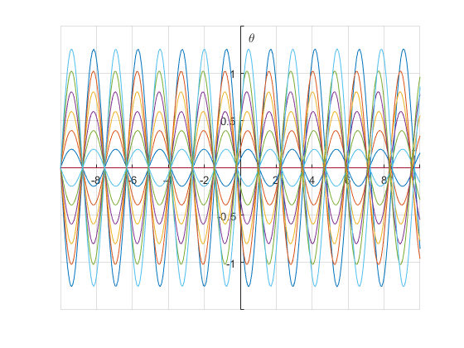
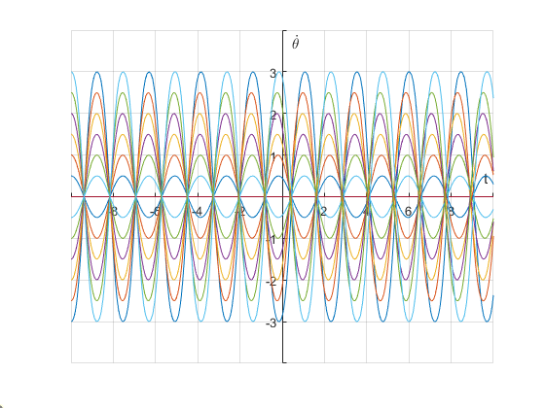
Phase Plots
Understanding the motion of the Bob
Small Oscillations

Slide 13
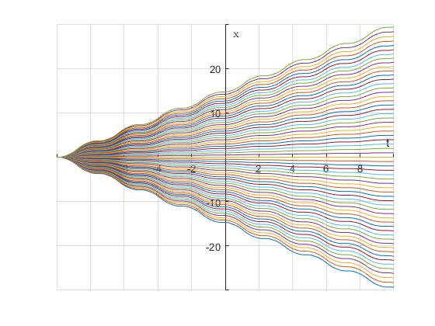
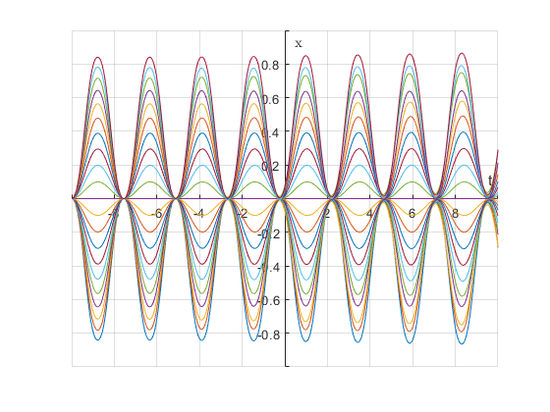
Phase Plots
Understanding the motion of the support
When an Initial Angular Momentum is given to bob
When an initial angular displacement is given to the bob

Slide 14
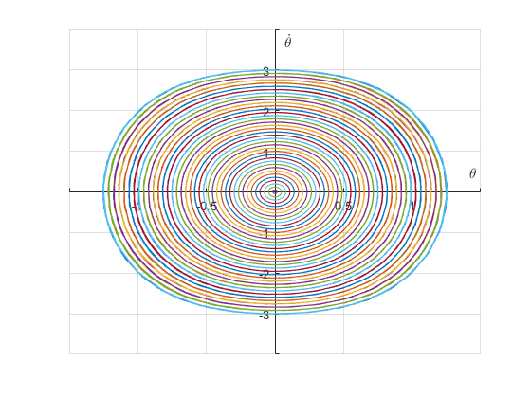
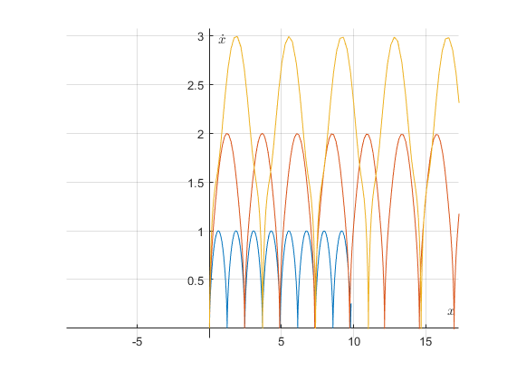
Phase Plots
Just seeing the remaining cases

Slide 15
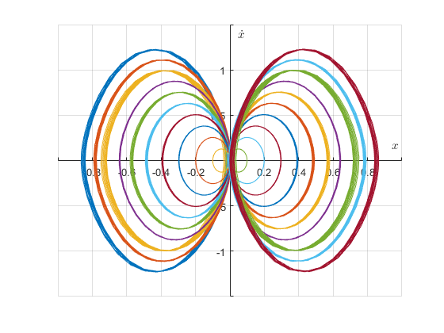
Behaviour of x
When an Initial Angular Momentum is given to bob
When an Initial Angular Displacement is given to bob

Slide 16
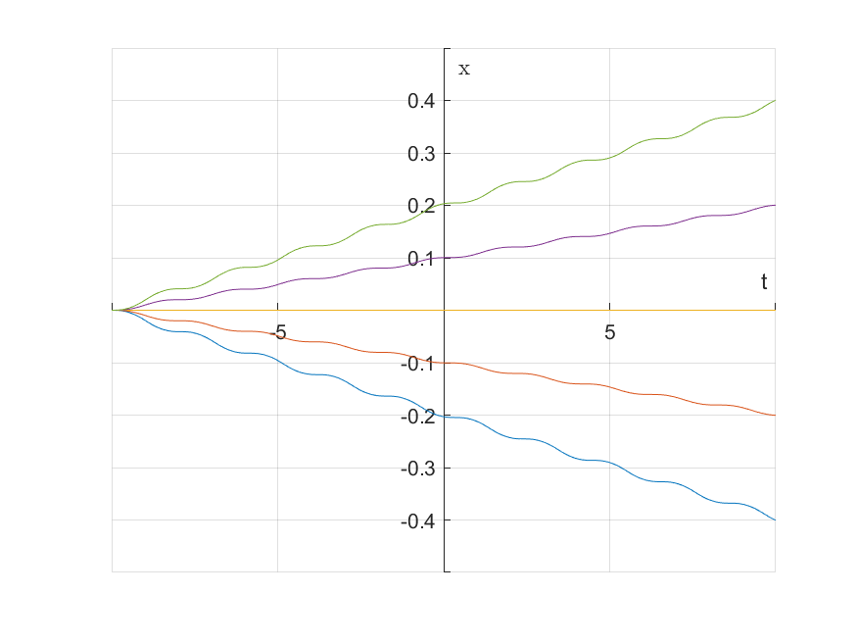
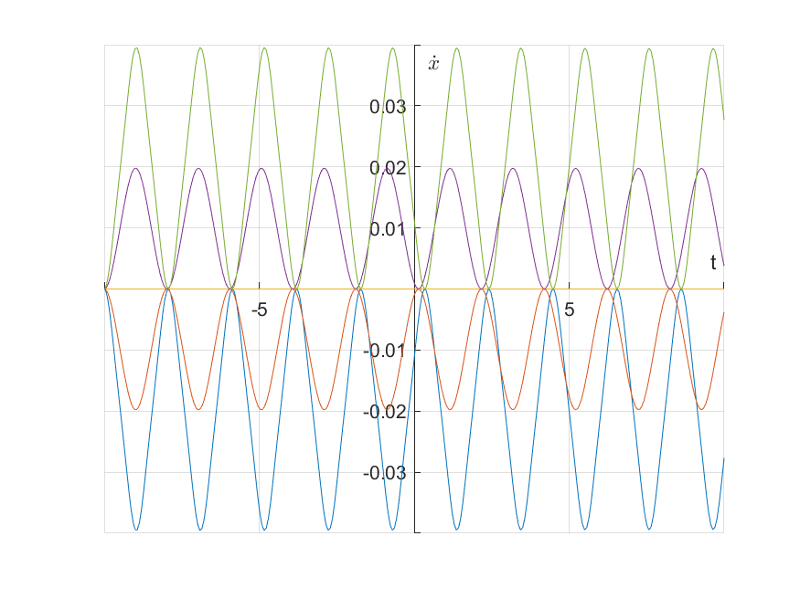
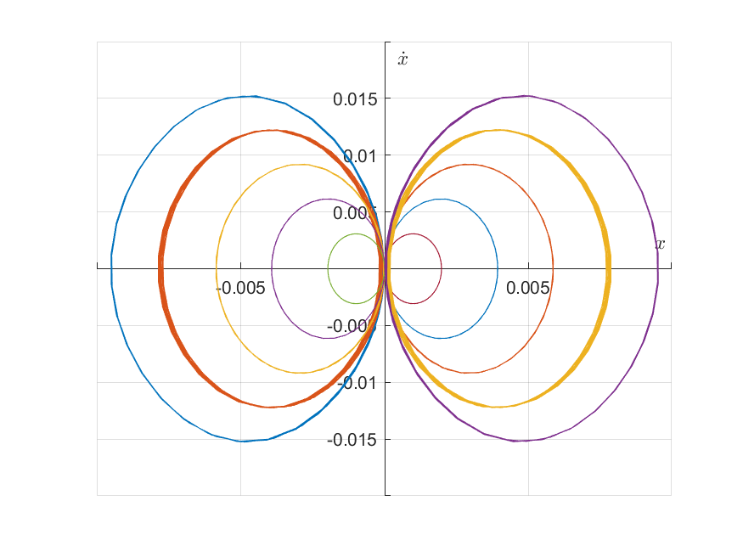
When Support overweighs the bob
Qualitatively there is not much change in the graphs, but the scales have changed.
Initial Ang Vel
Initial Ang Vel
Initial Ang Disp

Slide 17
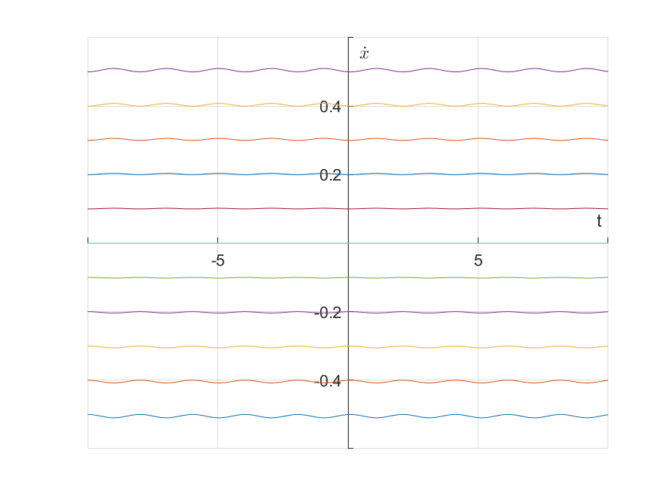
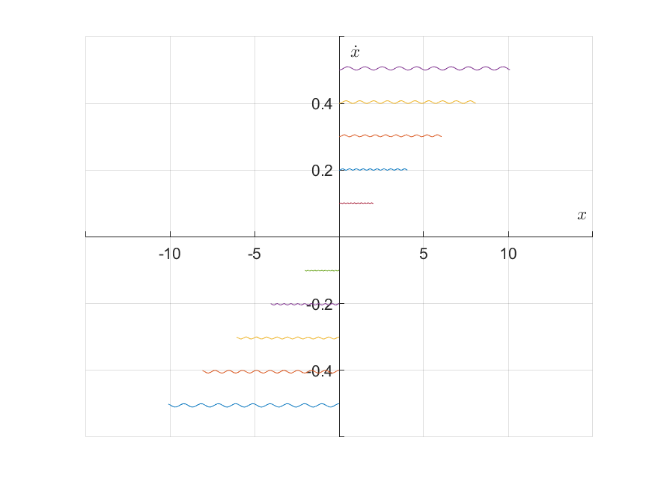
In Large Support Mass Systems
Large Support mass with initial velocity

Slide 18
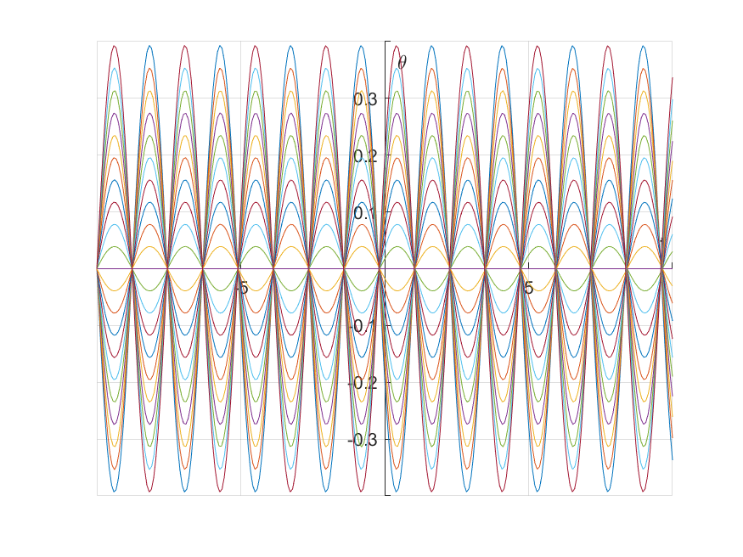
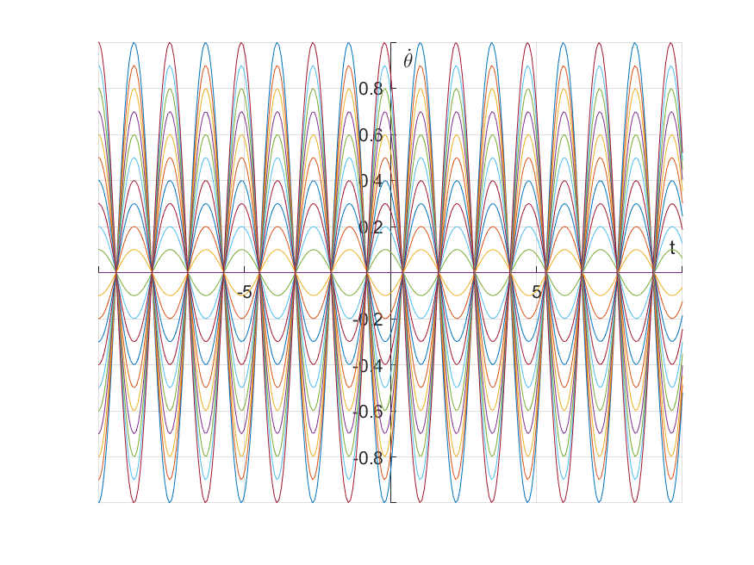
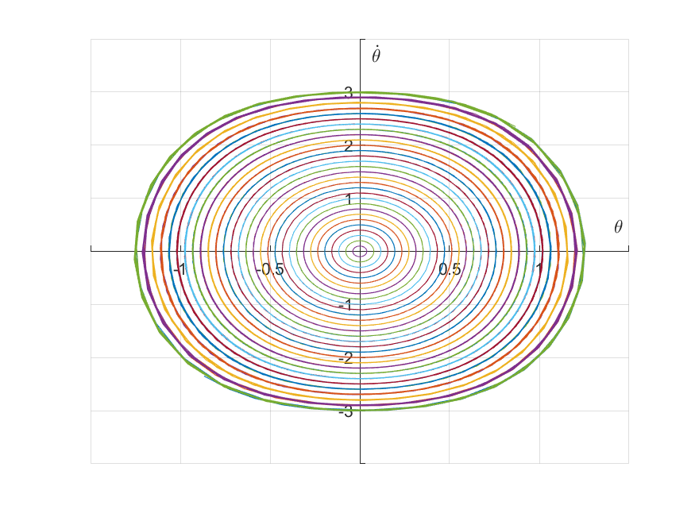
Bringing on the Perturbations to the Support
The oscillations of the bob are still almost undisturbed. The variations are still same as before.

Slide 19
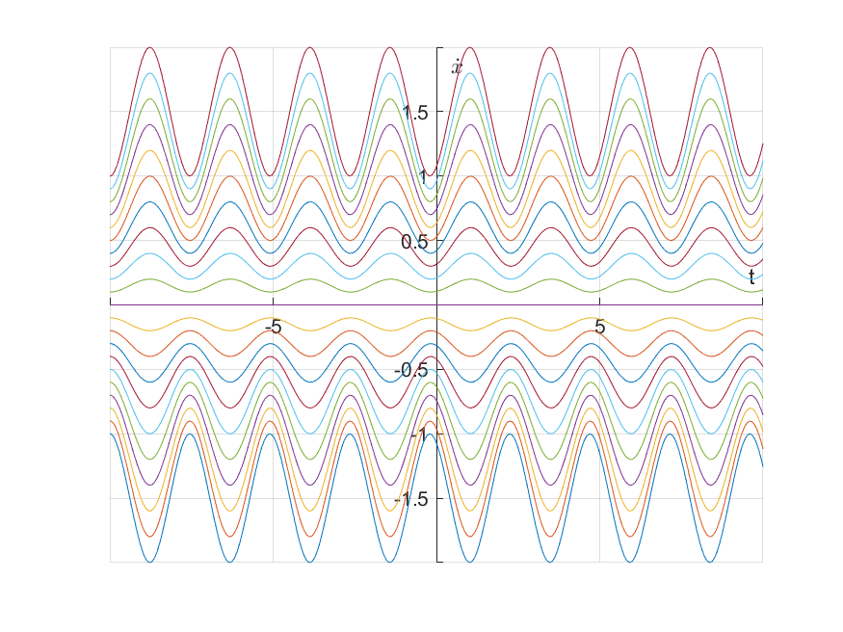
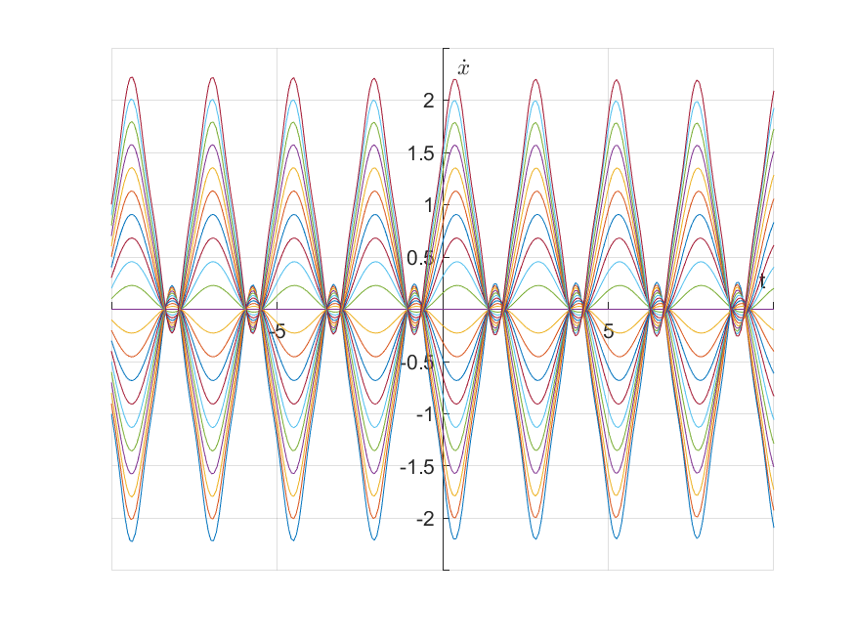
But the variation of x shows complexity
Same Masses, Initial vel to support
Same Masses, Initial vel to support does not cancel the angular vel of bob

Slide 20
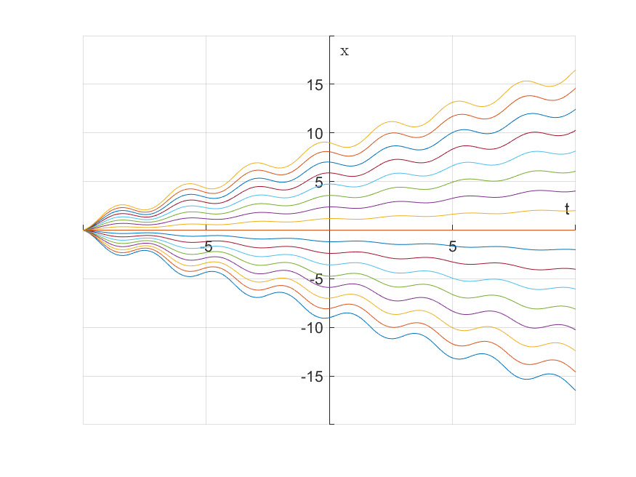
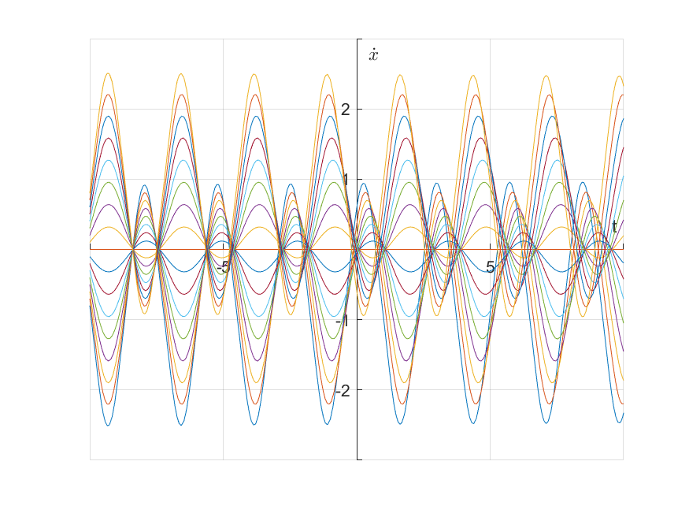
When Bob is much more massive
The oscillations of x become more pronounced.

Slide 21


Analytic Solution for Small Oscillations
For small oscillations where we approximate follows,
Substituting the above approximations into the Lagrangian obtained earlier and dropping the cubic and quadratic terms, we obtain,

Slide 22






Using the Euler Lagrange Equations,
By eliminating from two equations:
This is just like the equation of the simple harmonic oscillator.

Slide 23


The solution to this is that of a simple harmonic oscillator with frequency,
We get the solution as,

Slide 24
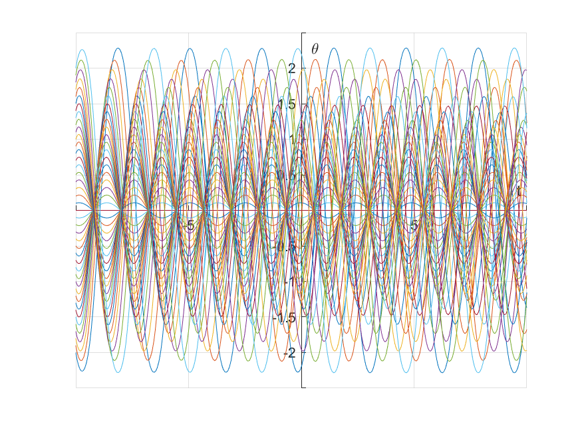
Solving for Large Oscillations

Slide 25
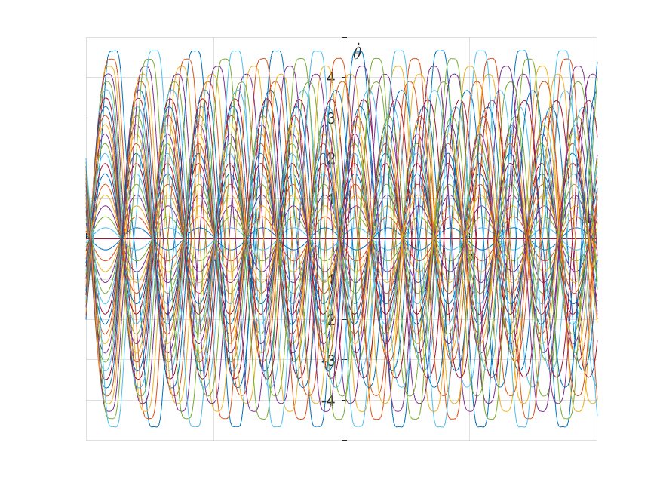
More Chaos

Slide 26
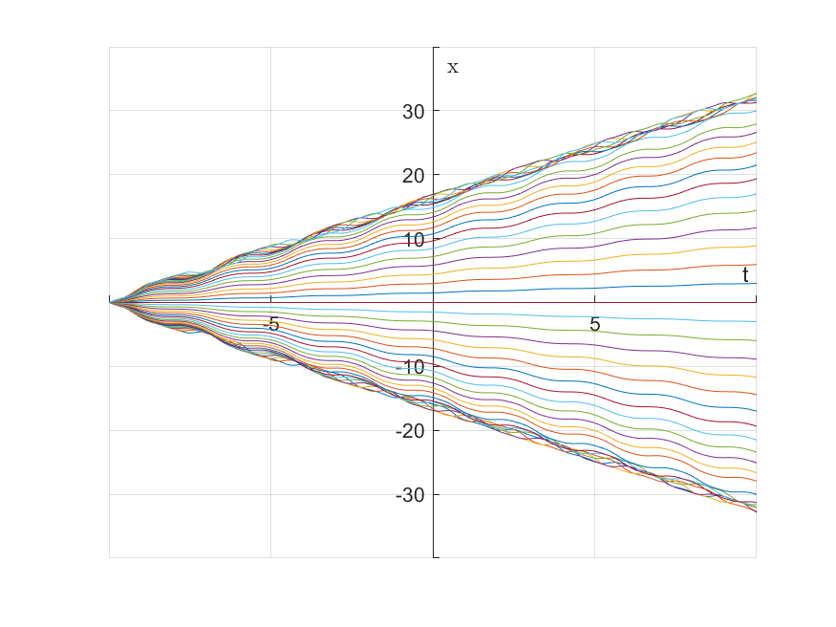
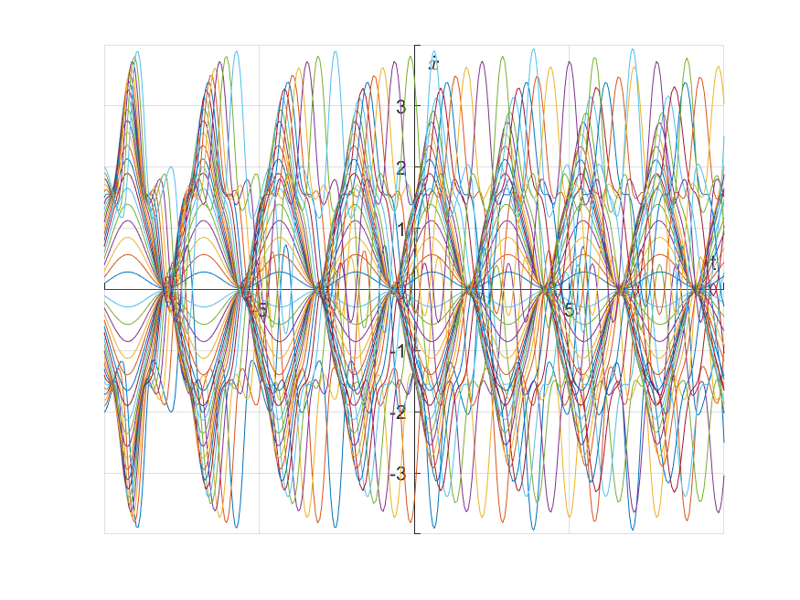
Chaos Continues
While x may seems to be non-chaotic the variation of its derivative is complicated.

Slide 27
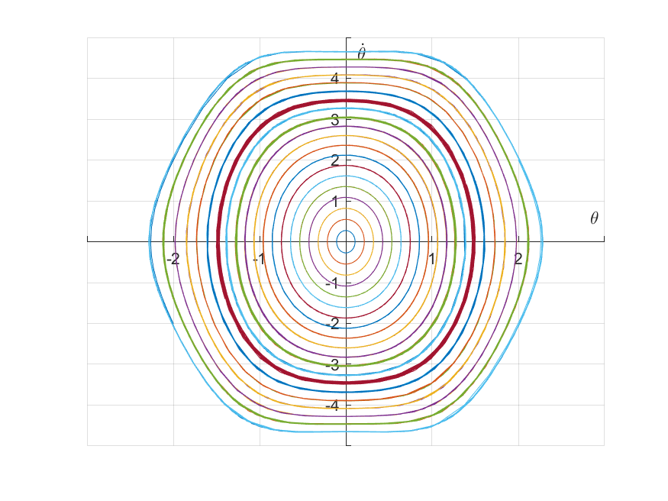
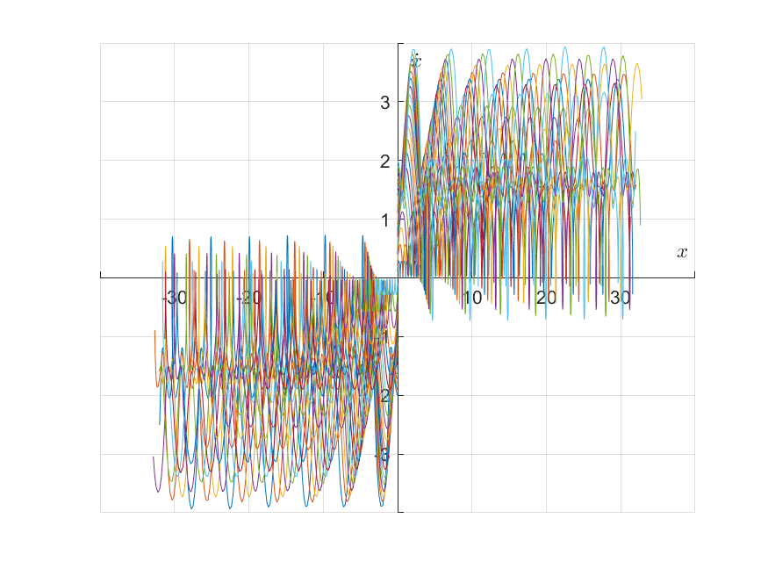
All this when we didn’t even reach the Directrix

Slide 28
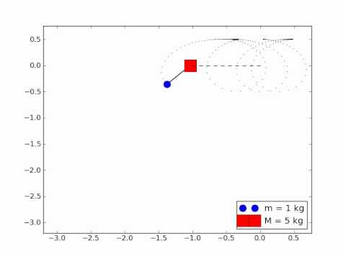
A feel for more Energetic Oscillations
Source: Youtube

Slide 29
Sources and References:
1. Goldstein,Poole,Safko - Classical Mechanics
2. Laundau Lifshiftz, Mechanics
3. J. R. Taylor Classical Mechanics

Slide 30
Acknowledgement
We take this opportunity to express our profound gratitude and deep regards to our Professors, Prof. Krishna Kumar and Prof. Kannabiran Seshasayanan for their exemplary guidance, monitoring and constant encouragement throughout the course of this project. They have been a constant light and we will carry around your lessons for the rest of our lives.At last but not the least we are thankful to our peers who had the patience to bear through with us.

Slide 31


